Slide 1

Sum Product Network Cloud-Edge Co-Inference
Advanced Topics In Cloud Computing
Daniel Redder

Slide 2
Contents
Background
Problem Statement
Related Work & Contributions
Naïve Scope Partitioning
Naïve Node Algorithm
Naïve Partitioning
Path Aware Partitioning
Cloud Communication
MicroSPN
Results

Slide 3
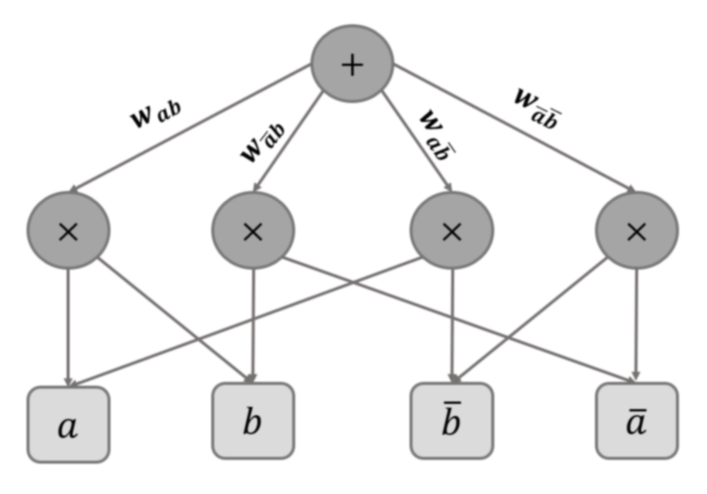
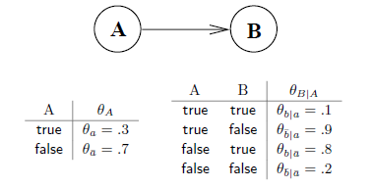
Background
Sum Product Networks
Linear inference time
Fast training
models a Joint distribution
Marginal P(X_1)
Joint P(X_1, not X_2, X_3, …)
Conditional P(X_1 | X_2) --requires two passes
Most probable explanation
Ideal for edge and IOT devices
Flexible
Fast

Slide 4
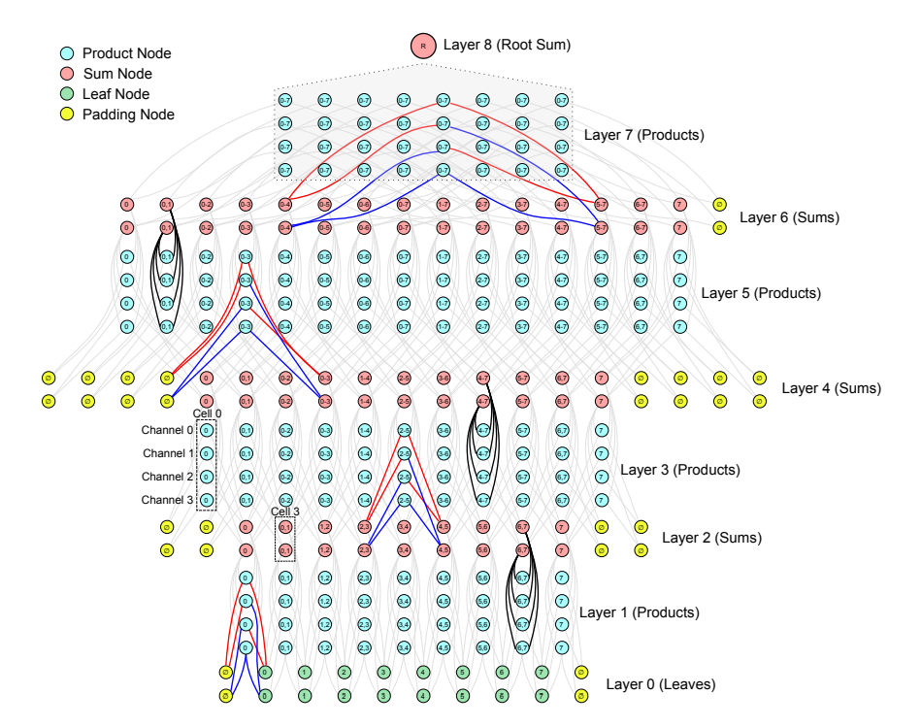
Problem Statement
Sum Product Networks scale exponentially in the #inputs and domain complexity
Deep Generalized Convolutional SPNs (DGCSPN) take 30GB of memory to load a model for 256x256 color images
Research Question: can memory overhead of running SPNs on memory constrained devices be handled by the cloud without compromising performance
Null Hypothesis: A optimal partition which splits a SPN model into nodes for processing on an edge device and cloud device will choose to only use the edge device

Slide 5
Related Work
“An Open-Source MLIR-Based Compiler for Fast Sum-Product Network Inference on CPUs and GPUs”:
A SPN compiler which proposes a partitioning function for handling large memory requirement SPNs
Both our proposed approaches differ from this
“DPU: DAG Processing Unit for Irregular Graphs With Precision-Scalable Posit Arithmetic in 28 nm”:
A SPN dedicated processor. Also introduces a partitioner
partitions independent sections, but does not account for latency between “superlayers”

Slide 6
My Contributions
A Naïve Partitioning Approach Naïvely splits the network using a node counter
An Aware Path Partitioner Splits the network logically
“MicroSPN” a limited implementation of SPFlow for microcontrollers
The results from running these functions over a common SPN testbed

Slide 7
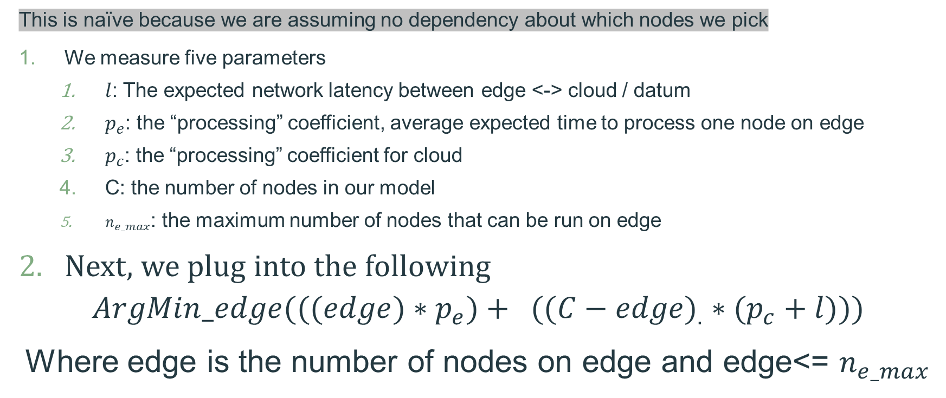
Approach – Naïve Node Algorithm
This is naïve because we are assuming no dependency about which nodes we pick
We measure five parameters
$l$: The expected network latency between edge <-> cloud / datum
$p_{e}$: the “processing” coefficient, average expected time to process one node on edge
$p_{c}$: the “processing” coefficient for cloud
C: the number of nodes in our model
$n_{e_max}$: the maximum number of nodes that can be run on edge
Next, we plug into the following
$${ArgMin_edge(((edge)∗p_{e})+ ((C−edge)}_{.}∗(p_{c}+l)))$$
Where edge is the number of nodes on edge and edge<= $n_{e_max}$

Slide 8
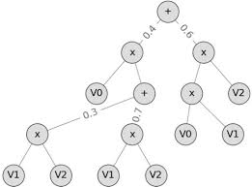
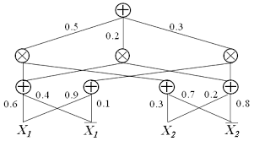


Approach – Naïve Scope Partitioning (theory)
input n, the number of op nodes on edge
return two partitions
The SPNs generated by SPFlow are valid SPNs and have the unique property of each substructure also being a SPN
SPNs have a concept of scope --------------------→
Maximizing Scope
We start at the leaves
By maximizing the scope, we move network communications dependency later
*not a perfect approach
From [0], the scope of the red Sum Node is [x_1, not x_1] and the scope of the root sum node is [x_1, not x_1, x_2, not x_2]
From [2], A TreeSPN learned from SPFlow

Slide 9




Approach – Naïve Scope Partitioning (algo)
We take as input n, the number of op nodes on edge
calculate the scope at all op nodes
count #descendants of all op nodes (dynamic programming)
If there is a node with fewer descendants and a larger scope, return the larger partition
If there is a match to the number of op nodes, return that partition
Else we rerun the Naïve node minimization over all available options and return the best
n=2
n=7
n=3

Slide 10


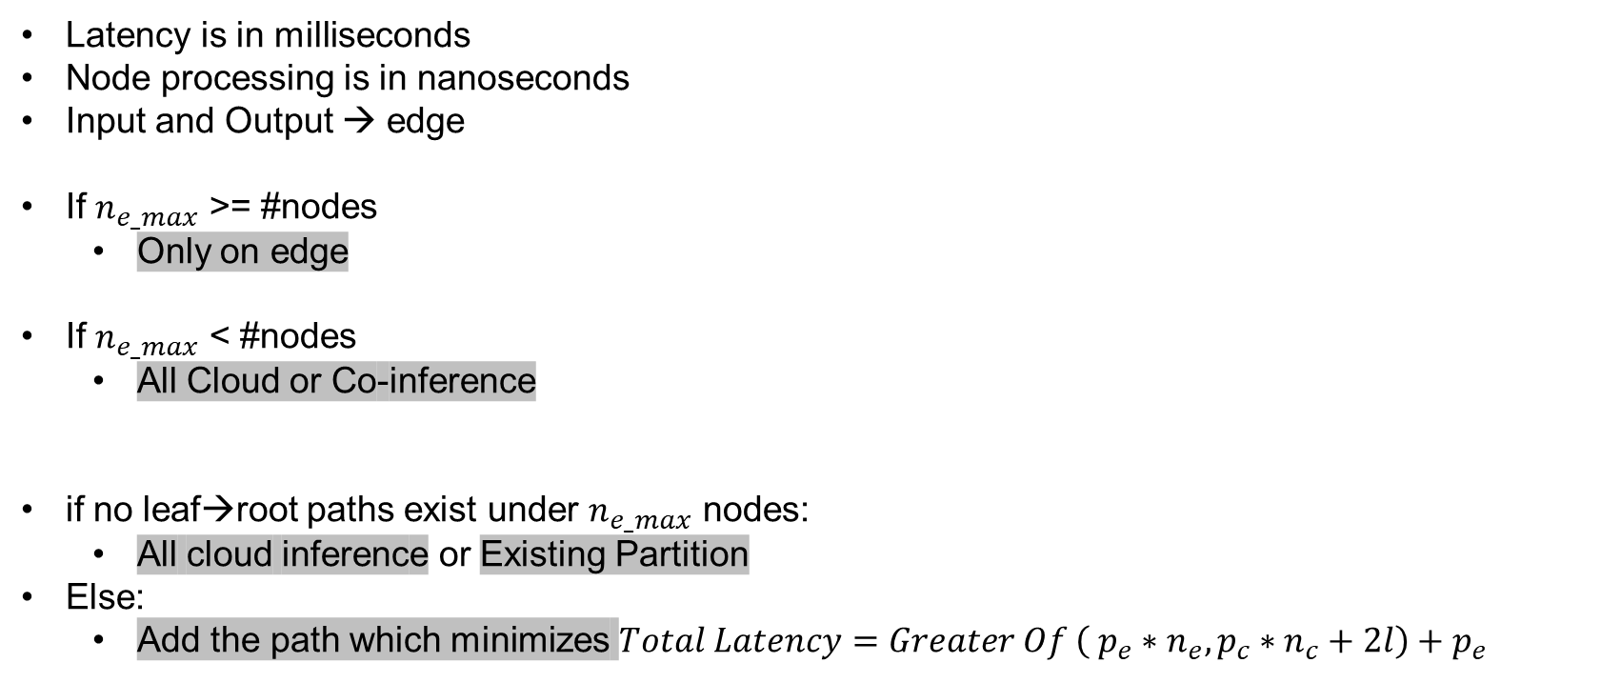
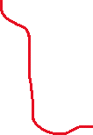

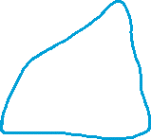
Approach – Aware Path partitioning
Latency is in milliseconds
Node processing is in nanoseconds
Input and Output → edge
If $n_{e_max}$ >= #nodes
Only on edge
If $n_{e_max}$ < #nodes
All Cloud or Co-inference
if no leaf→root paths exist under $n_{e_max}$ nodes:
All cloud inference or Existing Partition
Else:
Add the path which minimizes $Total Latency=Greater Of \left( p_{e}∗n_{e}, p_{c}∗n_{c}+2l\right)+p_{e}$
If edge not at Leaf
2x network latency added
If edge not path to root
2x network latency added
We want: Full paths leaf→root

Slide 11
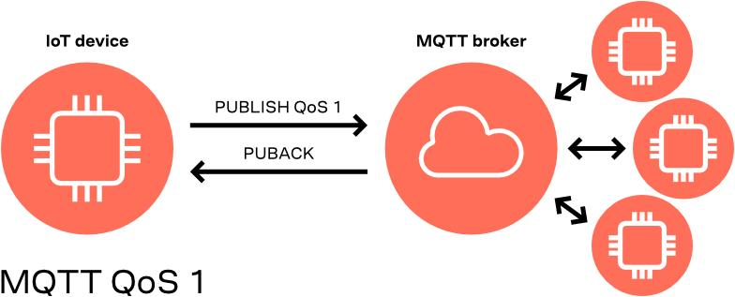
Approach – Cloud Connection
AWS IoT Core – MQTT communication
Simple Queue Service (FIFO queue)
EC2 worker
MQTT publish topic
IoT communication path for Microprocessor without CLI/sdk support
BOTO3 python sdk
EC2 Worker Master
BOTO3 Response
EC2 worker bots
Alternative communication route for full Python implementations
Diagram of MQTT, a IoT communication protocol

Slide 12
Approach - Micro SPN
Offline Process
SPFlow: the most popular SPN implementation
Highly relies on numpy
Has significant overhead for a microcontroller
MicroSPFlow:
We utilize SPFlow string formatting of SPNs
We perform Joint, and Marginal inference
We communicate with AWS IOT core through MQTT
Utilizes SPFlow DSL for storing/Running SPNs
profiling_microspn → $p_{e},p_{c},l$ Edge ←→ Cloud
Aware_path_partitioner( $n_{e_max}$ ) → edgePart, cloudPart
Edge Cloud
Online Process
co_inference(marginals, data) Edge
@Asynchronous
Root Sum Calculation(edgePartResult, cloudPartResult)
Await
processing (edgePart, marginals, data) – marginal overhead
Await
cloudprocessing(cloudPart,marginals,data) – MQTT
SPFlow, Domain Specific Language

Slide 13
Experiment Configuration & Variables
Cloud
AWS
1 t2.micro – us-east-1
Marginal vs Joint inference: marginal has additional overhead
Total Latency: the latency from sending the cloud partition to finalizing the inference
Edge Latency: time to process edge nodes
Cloud Latency: time to process cloud nodes plus network overhead
$n_{e_max}$: artificial maximum number of nodes
𝒏_(𝒆\_𝒎𝒂𝒙): artificial maximum number of nodes
Aware Path Partitioning & MQTT
Desktop-Baseline
32gb Memory
6 core x86 Intel I7 8600k
Raspberry Pi 4
8gb Memory
Quadcore ARM Cortex-A72
Raspberry Pi Zero W
512MB memory
Singlecore ARM Cortex-A53
Raspberry Pi Pico W (microprocessor)
264kB memory
Dual-core ARM Cortex-M0+
MQTT SSL failure

Slide 14
Testbed
Dataset | #nodes on SPFlow trained SPN
Baudio | 322
bnetflix | 350
jester | 255
kdd | 274
msnbc | 43
nltcs | 114
Histogram Leaves
Discretized variables
Additional processing step
Gaussian Mixture Model Leaves
computer vision
Not implemented
Trained with standard structure training from SPFlow, datasets from here https://github.com/SPFlow/SPFlow/tree/master/src/spn/data/binary

Slide 15
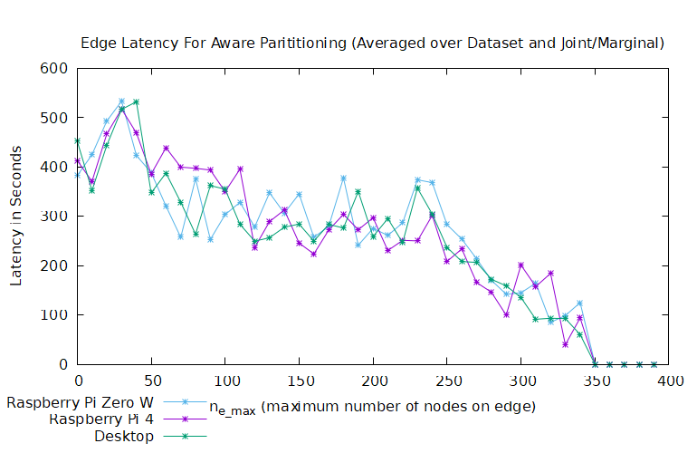
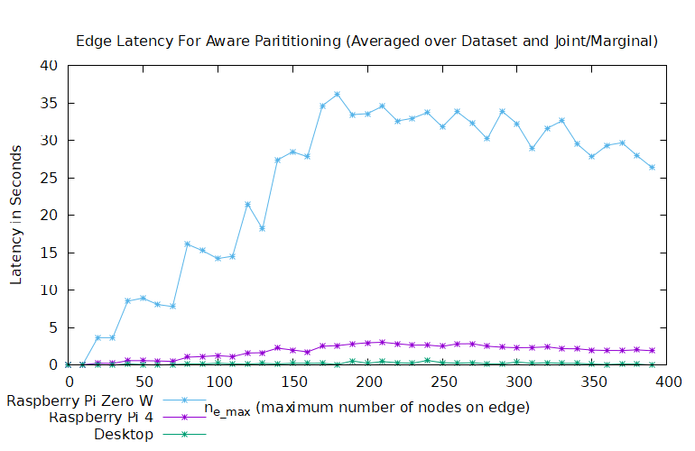
Results – Comparative Latency

Slide 16
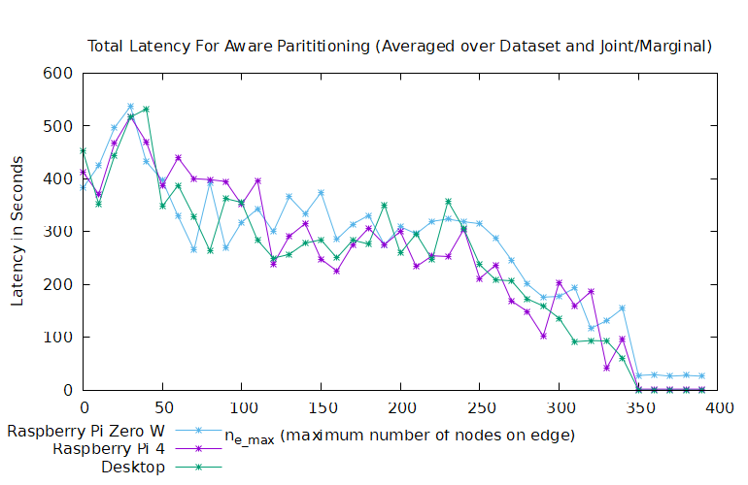
Results – Total Latency

Slide 17
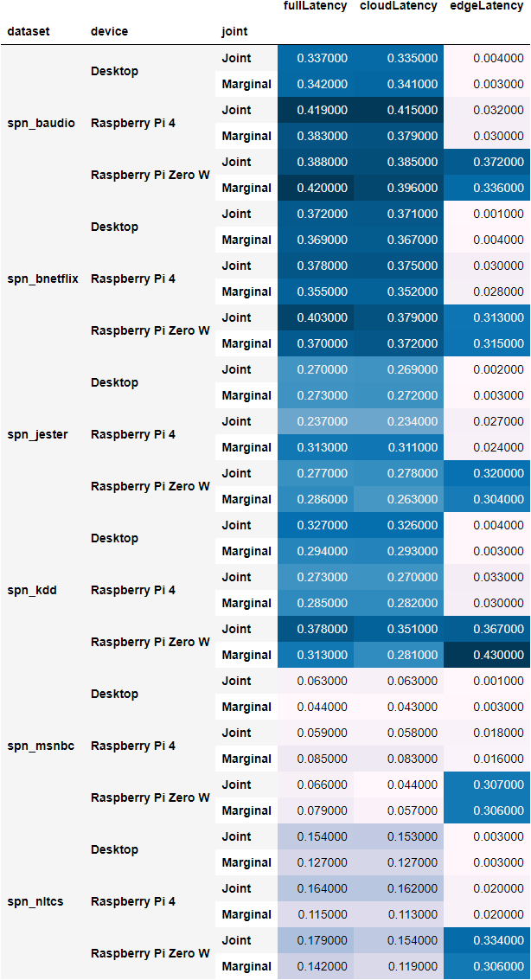
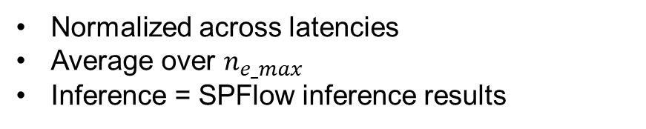
Results – Overall Data
Normalized across latencies
Average over $n_{e_max}$
Inference = SPFlow inference results
Dataset | #nodes on SPFlow trained SPN
Baudio | 322
bnetflix | 350
jester | 255
kdd | 274
msnbc | 43
nltcs | 114

Slide 18
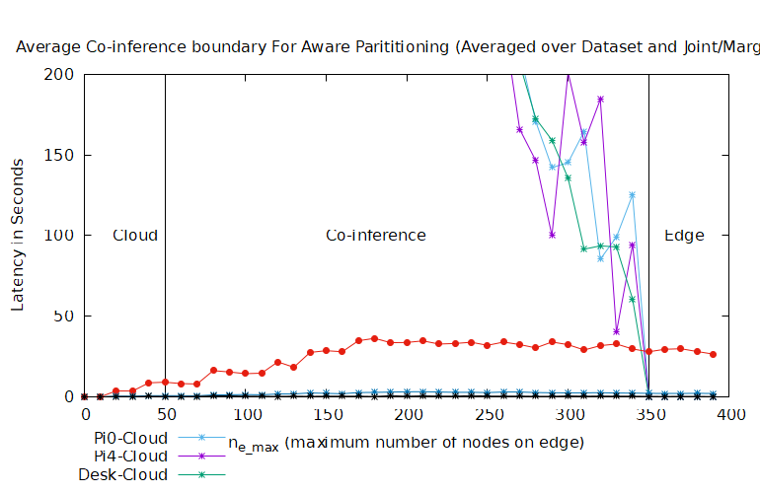
Results – Co-inference Switch

Slide 19
Conclusion
The Code: https://github.com/daniel-redder/MicroSPFlow/tree/master/src
Co-inference solves memory overhead
Total Latency decreases with the number of nodes given to Edge
Future Work
More powerful cloud hardware / serverless (works with framework)
Truly constrained device testing
Computer vision applications

